Slide 1
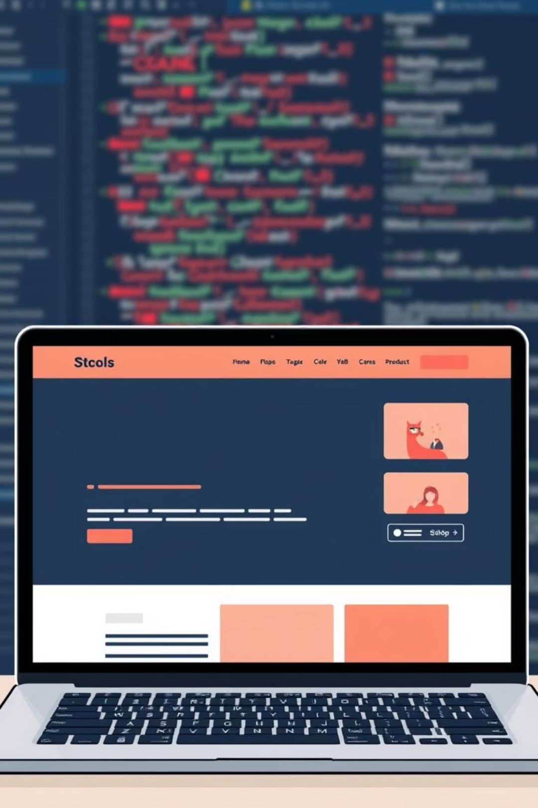
Building My Digital Identity: A Portfolio Website Showcase
Welcome! This presentation walks through the creation of my personal portfolio website, a cornerstone of my professional online presence. It's more than just a project; it's a testament to my skills in web development, designed to offer a comprehensive look at my capabilities and work.

Slide 2
Agenda: Unveiling the Journey
01
02
03
Project Genesis
Tech Stack Deep Dive
Development Lifecycle
Understanding the core objective and scope.
Exploring the technologies that powered the build.
From initial design to seamless deployment.
04
05
Anatomy of the Site
Insights & Impact
Dissecting the structure and key features.
Key takeaways and the project's significance.

Slide 3

Project Goal: Building a Digital Resume
Objective: Create a singular, organized platform to effectively display my diverse skills and completed projects.
Core Concept: Design a website that is not only clean and visually appealing but also highly responsive and intuitive to navigate, ensuring a smooth user experience across all devices.
Deployment Strategy: Leverage GitHub Pages for free, reliable hosting, making my professional showcase publicly accessible and easy to share.

Slide 4




Foundation of Innovation: Technologies & Tools
HTML5: Structure
CSS3: Style
The backbone of the website, providing semantic and accessible content organization.
Elevating aesthetics with modern styling, responsive layouts, and elegant typography.
JavaScript: Interactivity
Git & GitHub: Control
Injecting dynamic elements and enhancing user engagement with subtle animations and UX improvements.
Ensuring robust version control and seamless collaboration through an industry-standard workflow.

Slide 5




The Development Workflow: From Concept to Code
Initial Design & UI Sketching
Clean Coding & Styling
Began with wireframes and mockups, focusing on a minimalist and user-friendly interface.
Wrote semantic HTML and developed a custom CSS stylesheet for precise control over design elements.
Version Control with Git
Seamless GitHub Pages Deployment
Managed all code iterations and changes, ensuring a traceable and organized development history.
Utilized GitHub's integrated service for rapid and reliable live site publishing, ensuring continuous accessibility.

Slide 6
Website Architecture: Navigating the Experience
Key Sections
Core Features
Home: First impression, introductory overview.
Responsive Design: Optimized for seamless viewing across desktops, tablets, and mobile devices.
About Me: Personal story, professional background.
Skills: Detailed breakdown of technical proficiencies.
Intuitive Navigation: Clear, user-friendly menu structure for effortless browsing.
Projects: Showcase of past work with direct links.
Contact: Easy avenues for connection and inquiry.
Direct Links: Immediate access to project repositories and live demos for deeper engagement.

Slide 7



Impact & Insights: What I Learned
Full Web Development Lifecycle
Mastering Responsive Layouts
Project Validation
The successful completion of this portfolio website serves as concrete proof of my ability to build professional web applications from the ground up.
Gained invaluable hands-on experience, from initial conceptualization and design to coding, testing, and final deployment.
Successfully navigated the complexities of creating a truly adaptive design, ensuring optimal viewing across diverse screen sizes.

Slide 8

Future Enhancements: Expanding Horizons
Integrate a dynamic blog section to share insights and technical articles.
Explore API integrations for richer content, such as fetching project data dynamically.
Implement more advanced JavaScript frameworks (e.g., React, Vue) for complex UI interactions.
Optimize SEO to improve discoverability and online presence.
Add localization support for a broader audience.

Slide 9
The Big Picture: More Than Just Code
"This portfolio isn't just about demonstrating technical prowess; it's about showcasing the problem-solving mindset, attention to detail, and dedication to craft that I bring to every project."
— Bagrudeen Ahamed
It represents my ability to translate abstract ideas into tangible, functional digital solutions.

Slide 10

Thank You & Next Steps
Connect & Explore
Live Website:bagrudeen.github.io/ahamed-portfolio/
GitHub Repo:github.com/bagrudeen/ahamed-portfolio
Questions?
I welcome your questions and look forward to discussing how my skills can benefit your team.

